Slide 1
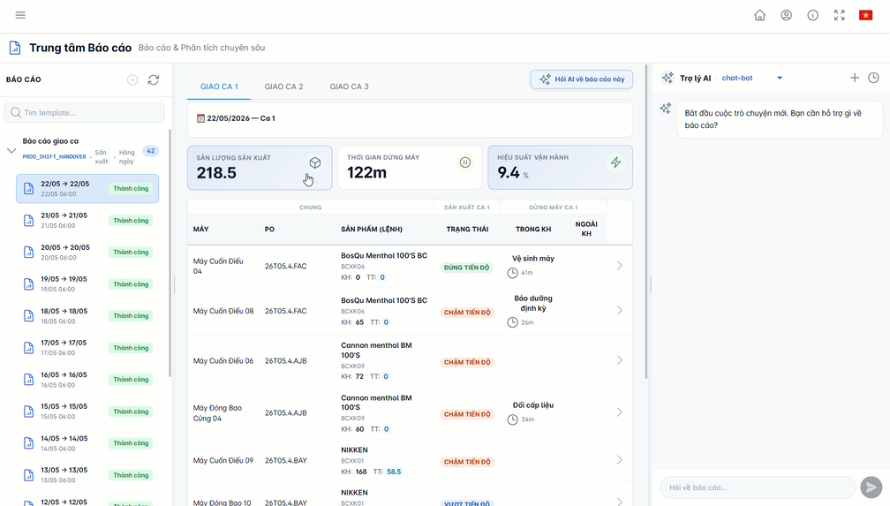
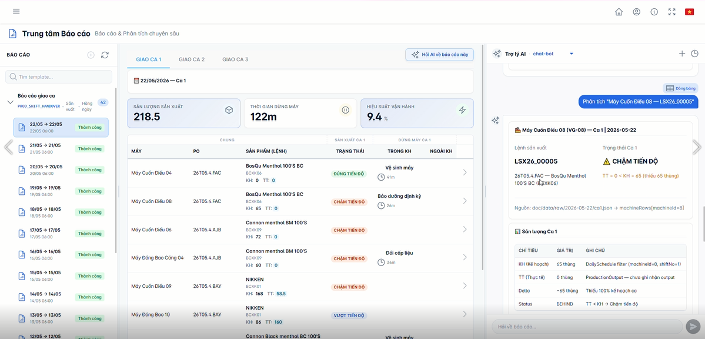
DxFactory
Operations
Intelligence
AI-Powered Insights For Smarter Manufacturing Decisions
One Platform. Three Perspectives.
Production
Maintenance
Management
Turn operational data into actionable insights
and automated reports.
One platform. Three operational perspectives.
Production | Maintenance | Management
Notes:
Open by positioning DxFactory Operations Intelligence as a single AI-powered layer for smarter manufacturing decisions. Emphasize that the platform speaks to three roles at once: production, maintenance, and management.

Slide 2
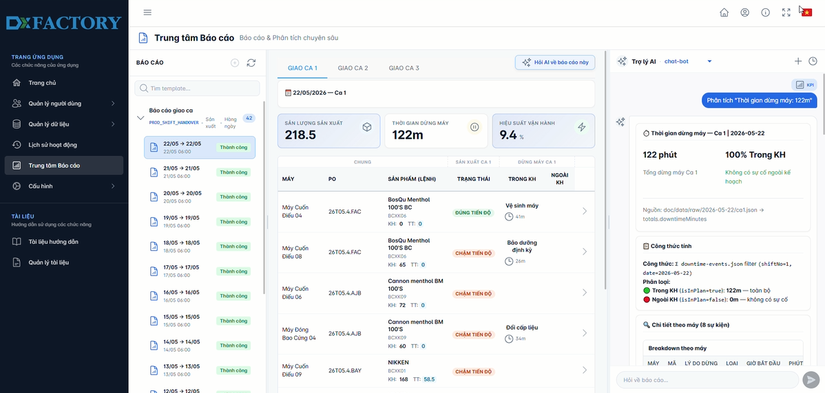
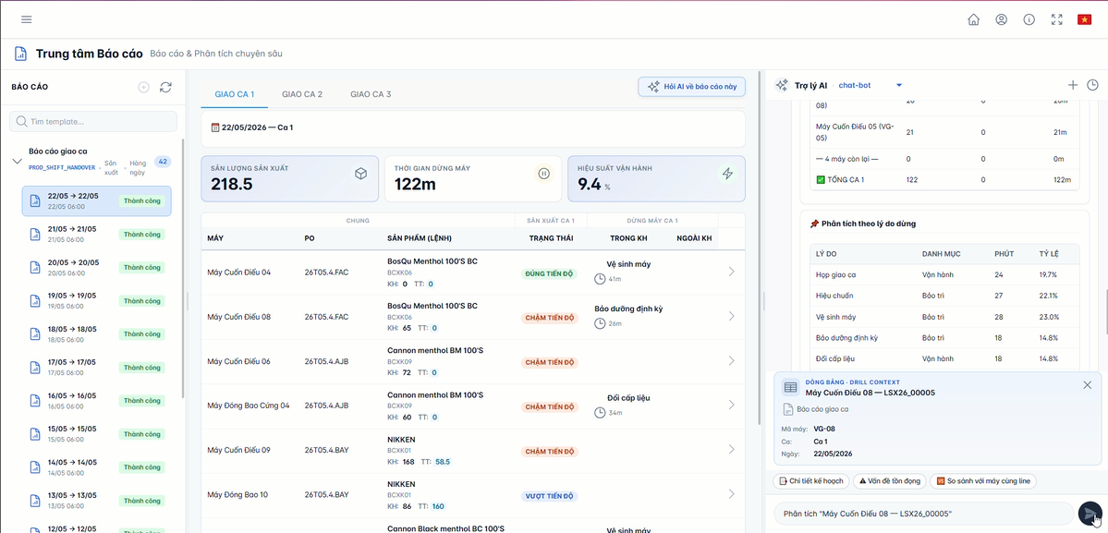
DXFACTORY OPERATIONS INTELLIGENCE
02 / 06
Intelligence For Every Operational Role
Production Intelligence
Maintenance Intelligence
Management Intelligence
- Automated shift handover reports
- Machine health monitoring
- Production KPI dashboard
- Production performance tracking
- PM due alerts
- OEE monitoring
- Downtime visibility
- MTTR / MTBF tracking
- Progress tracking
- Root cause analysis
- Equipment reliability insights
- Executive-level insights
Operational intelligence tailored to the decisions each role owns.
One platform. Three operational perspectives.
Production | Maintenance | Management
Notes:
Walk through the three operating perspectives. Production gets shift handover, performance, downtime, and root cause visibility. Maintenance gets machine health, preventive maintenance alerts, and reliability metrics. Management gets KPI, OEE, progress, and executive views.

Slide 3
DXFACTORY OPERATIONS INTELLIGENCE
03 / 06
Ask Your Factory Data
No More Searching Across Systems
Factory questions answered in plain language
Why is Line A behind schedule?
Excel
MES
CMMS
Which machine has the highest downtime today?
Production
Reports
What maintenance activities are overdue?
Simply Ask
What are the main causes of production loss?
Which production order requires attention?
Instant Answers.
Actionable Insights.
One platform. Three operational perspectives.
Production | Maintenance | Management
Notes:
This is the attention slide. Explain that teams no longer need to search MES, CMMS, Excel, and production reports separately. They can ask factory questions directly and receive instant, actionable answers.

Slide 4
DXFACTORY OPERATIONS INTELLIGENCE
04 / 06
Business Impact
60-70 Hours
<15 Minutes
Up To 20%
Saved Per Month
Decision Response
Reduction In
Time
Unplanned Downtime
+1% To +3%
Single Source
Potential OEE
Of Truth Across
Improvement
Manufacturing Operations
Less reporting time. Faster operating decisions.
One platform. Three operational perspectives.
Production | Maintenance | Management
Notes:
Summarize the expected business impact with the large numbers on screen: reporting time saved, faster decision response, reduced unplanned downtime, OEE potential, and a single source of truth.

Slide 5
DXFACTORY OPERATIONS INTELLIGENCE
05 / 06
From Data To Decisions
MES
Automated Reports
DxFactory
CMMS
Operations Intelligence
Operational Insights
Production Systems
Faster Decisions
Transform Data Into Business Value
Continuous Improvement
One platform. Three operational perspectives.
Production | Maintenance | Management
Notes:
Explain the operating flow: source systems feed DxFactory Operations Intelligence, which produces reports, insights, faster decisions, and continuous improvement.

Slide 6
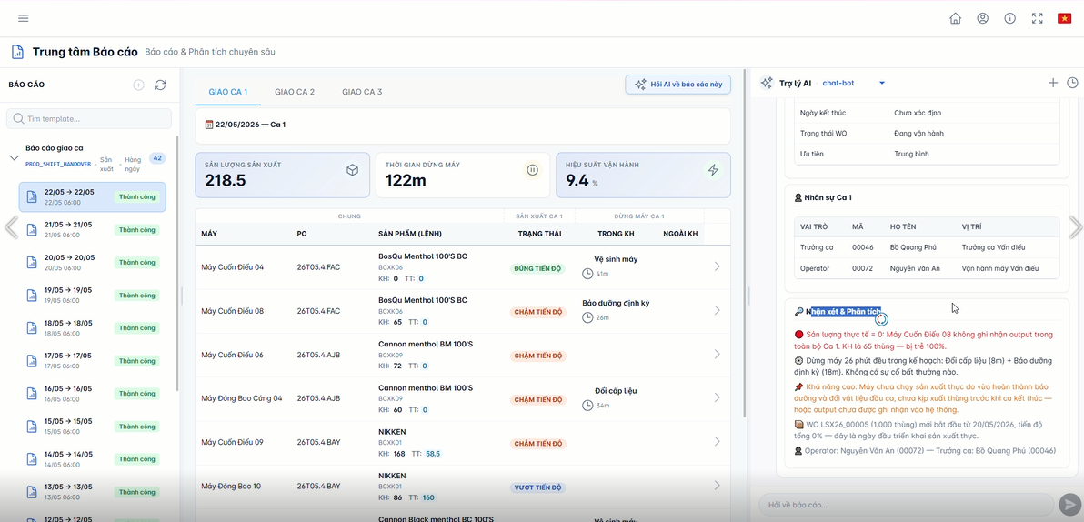
Live Demonstration
Experience Real Manufacturing Use Cases
Production Intelligence
Maintenance Intelligence
Management Intelligence
Visit Our Demo Station
See It In Action
One platform. Three operational perspectives.
Production | Maintenance | Management
Notes:
Close by inviting the audience to the demo station. Point out that the demo covers real production, maintenance, and management use cases, not a generic dashboard tour.

